Slide 1


Academic Advising Assistant Using Retrieval-Augmented Generation
Angelin Tisha – March 2026

Slide 2


Introduction
Why This Project?
Academic advising helps student understand:
Degree requirements
Course planning
Graduation progress
However:
Students frequently ask similar advising questions
Advisors spend time answering repetitive queries
Solution:
Develop an automated system that answers advising questions using institutional documents.

Slide 3
Project Objective
Develop an AI-powered academic advising assistant
Answers student questions about courses and programs
Use RAG, LangChain, and LLMs
Deploy a Streamlit application

Slide 4
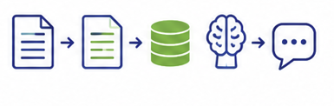
System Architecture
Institutional advising documents were collected and processed.
1
Documents converted into text and split into chunks.
2
Text chunks converted into embeddings.
3
Stored in a Chroma vector database.
4
User submits a question.
5
Relevant document chunks retrieved.
6
A locally hosted LLM via Ollama generates the final response.
7

Slide 5
Key Tools
Streamlit
Chroma
Ollama
LangChain
Python

Slide 6

Application Interface
Streamlit Advising Assistant
Features:
Interactive chat interface
Students ask advising questions
The application retrieves relevant document information
LLM generates responses
Examples:
Core courses in Marketing
Graduation requirements for Accounting
Course schedule and location
Instructor information

Slide 7

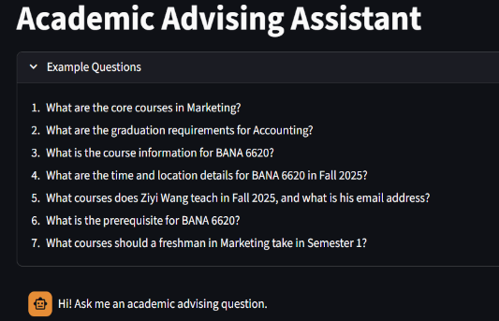
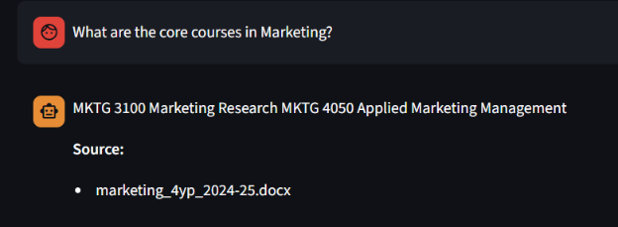
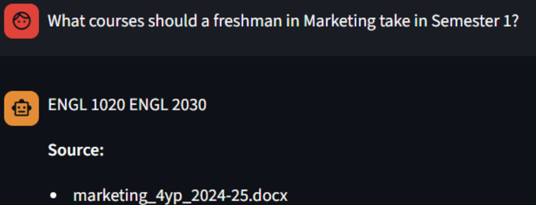
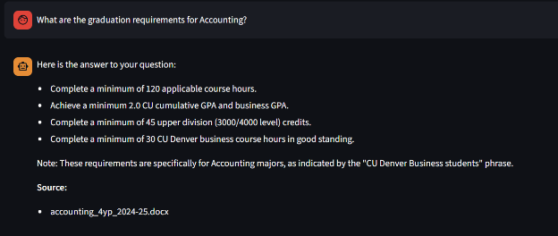
System Response Examples

Slide 8
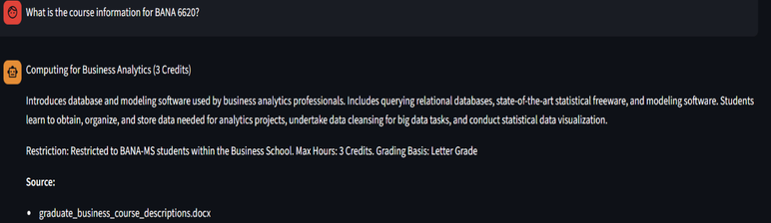
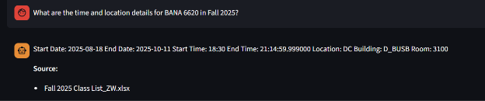
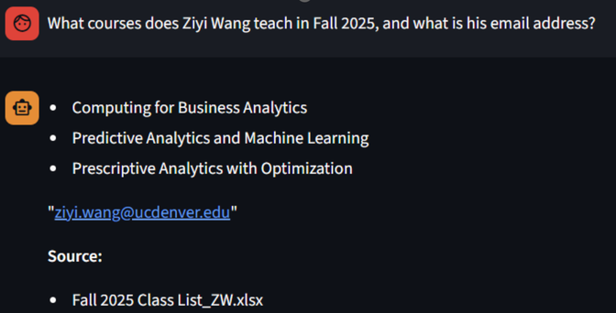
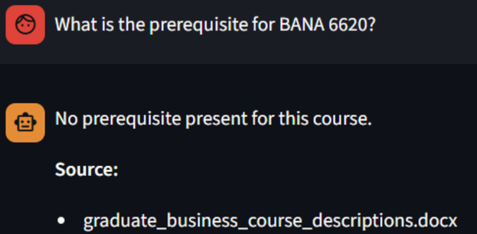
System Response Examples

Slide 9

Conclusion
Results
The RAG-based advising assistant successfully retrieves information from institutional documents
Answers common student advising questions.
Limitations
Tables from spreadsheets and word documents may lose structure.
Retrieval can still return noisy chunks if the documents are messy.
Provides an interactive advising tool.

Slide 10

Future Improvement
Better handling of tabular data.
Structured storage for schedules
Improved retrieval strategies

Slide 11

References
Chroma vector database
https://www.trychroma.com
LangChain documentation
https://python.langchain.com
Ollama: Run large language models locally
https://ollama.ai
Streamlit documentation
https://streamlit.io

Slide 12

Thank You

